Slide 1
Mandelbulb Visualizer
With
Raymarching Demo
Riley Mahr, Alex Stiyer

Slide 2
The Problem:
Implement a Ray Marcher in Unity Compute Shaders to Render a Mandelbulb. Include interactive Ray Marching demos for learning purposes.

Slide 3
What is a Shader?
GPU accelerated script that acts on all pixels of a view or all vertices of a shape
Entire shader script is ran for each Pixel or Vertex in parallel making this method of computer graphics extremely efficient
Can take advantage of dedicated logic units of GPU for matrix math, helper functions, and other graphics related calculations

Slide 4
Challenges of Using a Shader
Because you are working on a pixel/pixel level, creating shapes relies on stateless functions based on pixels.xy positions
In 2D you must use Distance Fields and Shaping Functions to create 2D shapes
In 3D we use Signed Distance Functions to represent Volumes
Notes:
Shaping functions include Sin, Cos, Step, Smoothstep,

Slide 5

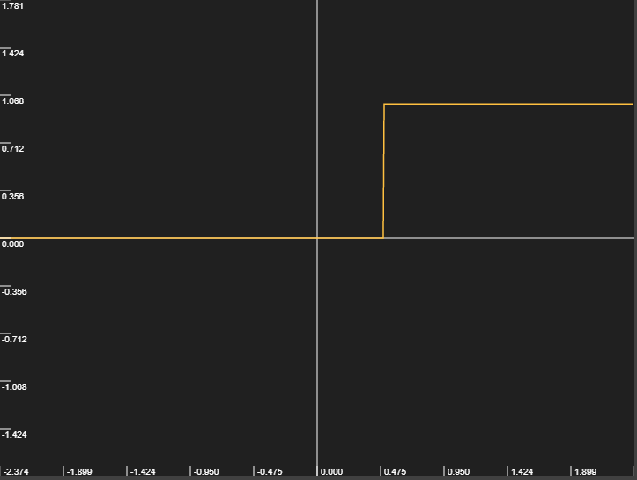

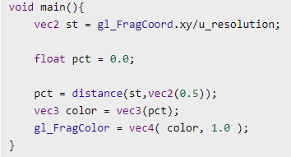
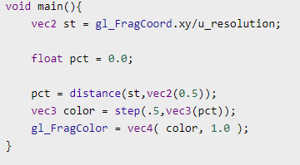
Example of Shaping Function with Distance Field
f(x) = step(.5,x)
vec3(pct) = (pct,pct,pct)
0,0,0 or 1,1,1
Notes:
These are fragment shaders, work on a pixel by pixel basis. Notice we are caclculating the distance from .5,.5 (the center for normalized coordinates) and turning that into a color. The farther away you are the closer the color gets to 1,1,1. Wherever the color is below .5,.5.5 we cut that off and turn it to 0,0,0 and the rest to 1,1,1,

Slide 6
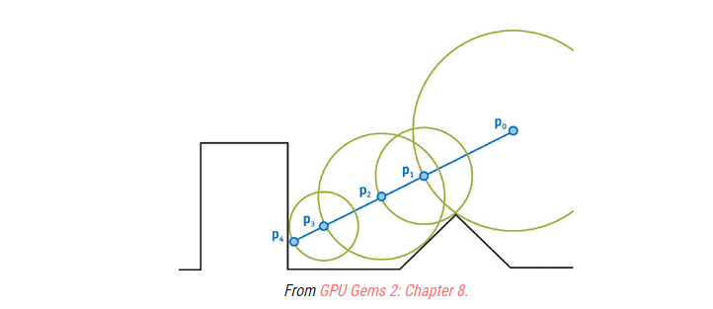
What is Ray Marching?
Raymarching is a rendering technique similar to ray tracing
Raymarching uses Signed Distance Functions to represent 3D volumes

Slide 7
Algorithm Steps
For each ray of the camera, given its direction and origin:
Marching_Point = origin
Calculate Distance to Surface (in any direction)
Guarantees we will not choose point inside surface
We will use SDF to represent surfaces
Move Marching_Point to calculated distance in direction opposite of camera
Repeat until the distance to surface is very small, we consider this a hit

Slide 8
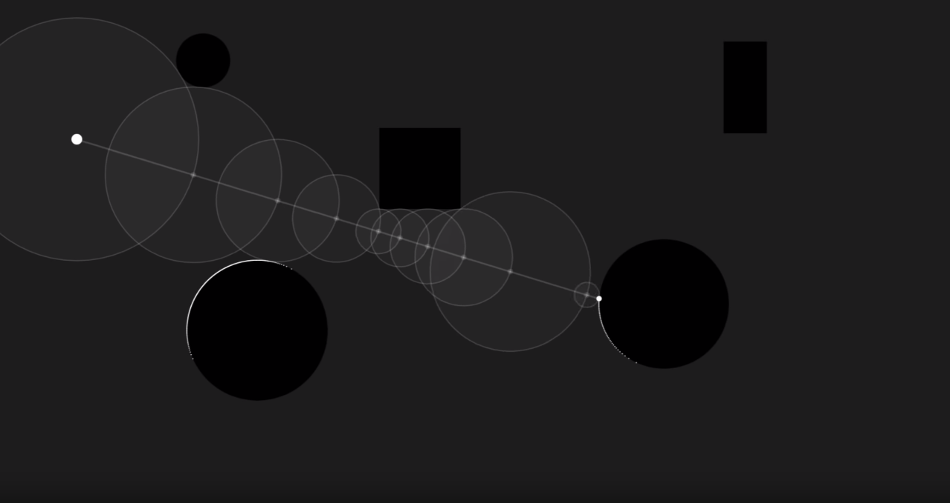
Youtube.com/Sebastian Lague

Slide 9

Example SDF (sphere)
Youtube.com/TheArtOfCode
Notes:
Note it will
If point is inside the radius it is negative, this will be useful later

Slide 10
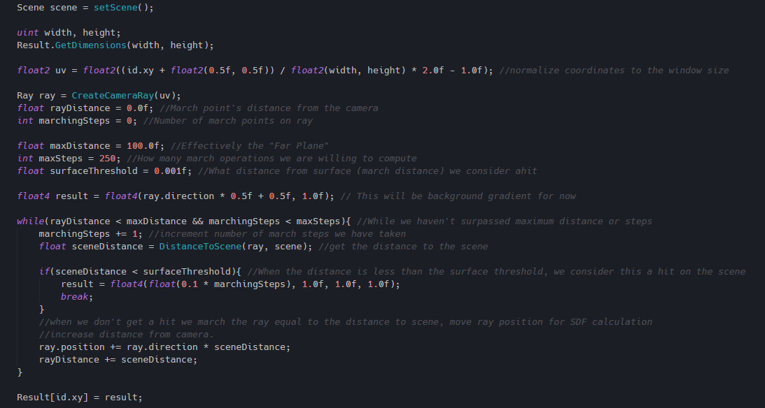
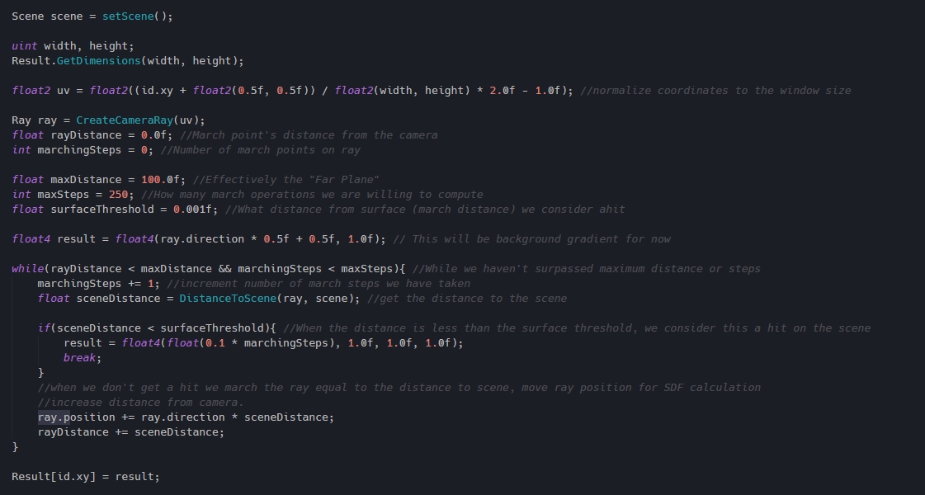
Main Loop:

Slide 11
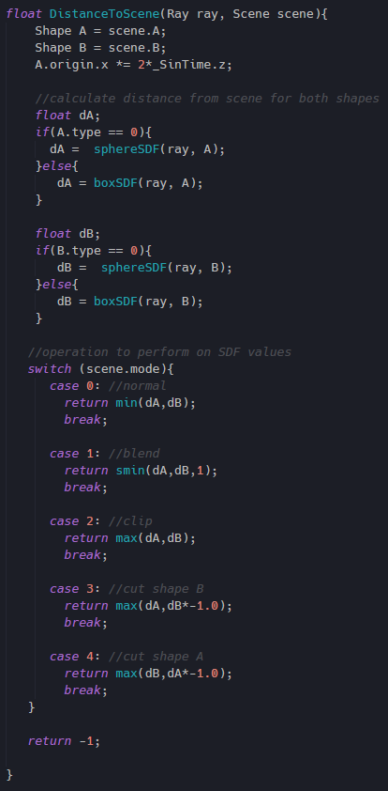
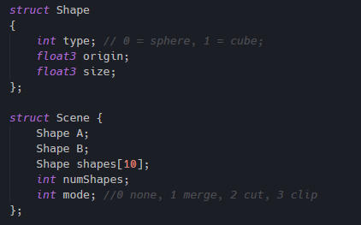
DistanceToScene
Notes:
Max: only shows between two shapes because the raymarcher only displays shapes when the distance is 0 or less (surface_threshold), because of this the shape only exists at the intersection of the two shapes.
Max( w/ -1d): This essentially makes the inside of the shape hollow and the outside solid, but because it is a max function, it again only exists at the intersection of the two shapes. Remember that if we are inside a shape the SDF is negative, by multiplying it by negative one we are making it positive and representing the intersection.

Slide 12
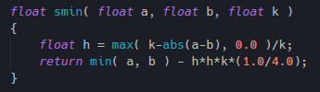
Smooth Min Function
Polynomial Method from Inigo Quilez

Slide 13
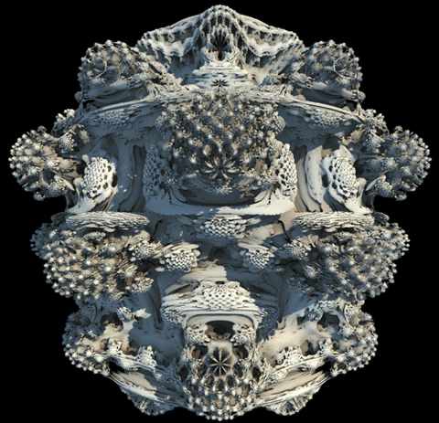
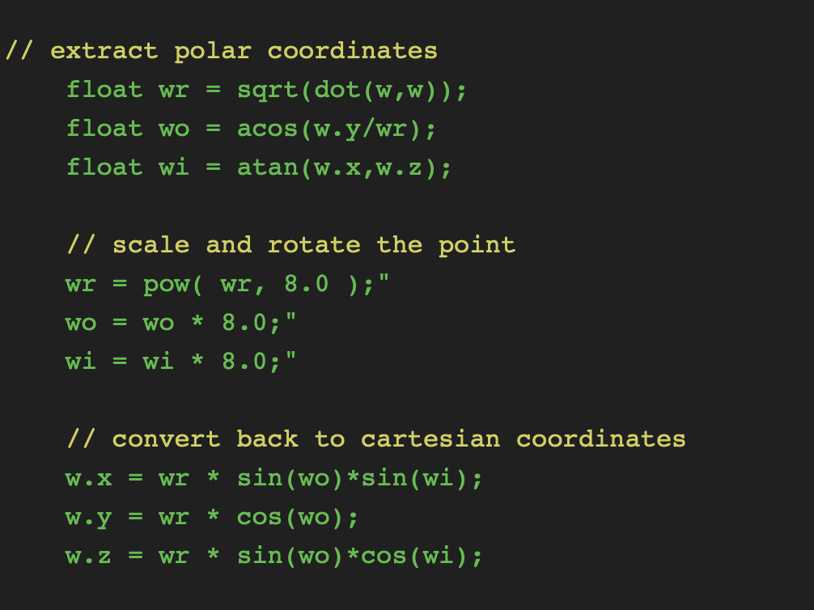
3D Fractal
Expansion of MandelBrot set into 3D
https://www.iquilezles.org/www/articles/mandelbulb/mandelbulb.htm

Slide 14
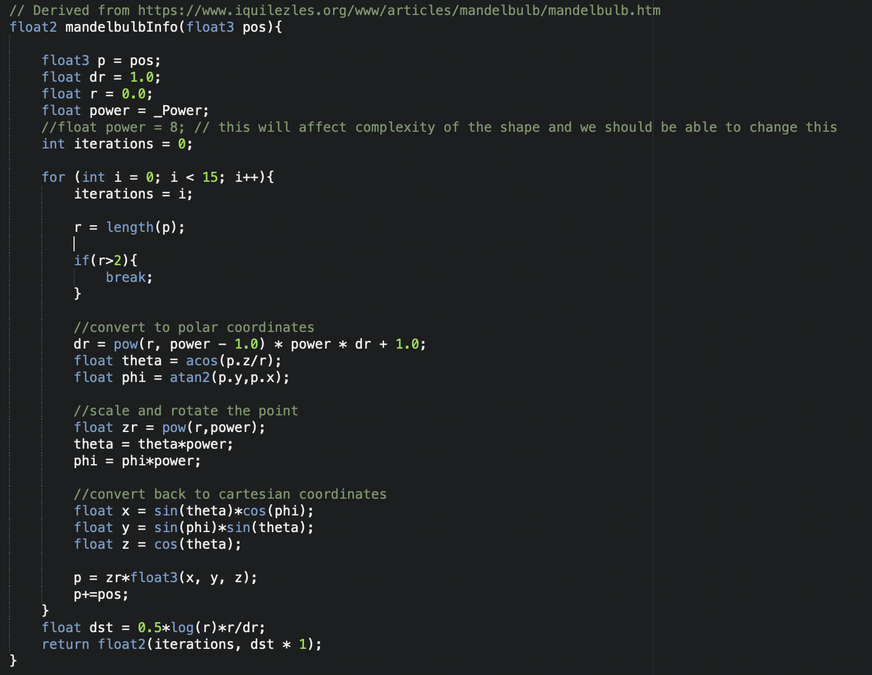
3D Fractal

Slide 15
3D Fractal
Accomplished in same manner as SDF raymarching using the previous function.
Demonstrates strong use case for raymarching when volumetric expressions are focus of rendering.
An example of 3d fractals can be seen in Big Hero 6, when the main characters go through a portal.
Many implementations can be found on websites like shadertoy.
https://www.iquilezles.org/www/articles/mandelbulb/mandelbulb.htm

Slide 16
Unity 3D
For this project, Unity 3D, a popular game engine was used. Shader code was custom written, but the use of the engine allows for:
Compilation of shader code for multiple targets/platforms (Metal, Vulkan, Directx, etc.)
Easy set up of shader code
Built in handling of windowing systems and computer recognition of graphics pipelines (for example, GeForce experience recognizes the build on Windows 10)
Use of a physically accurate camera and the necessary matrices for creating a ray marcher (or ray tracer)
Handling of unimportant items like interface, help menus, and key detection so efforts could be focused elsewhere.
Easy adjustment and saving of user defined parameters.
https://unity.com

Slide 17
Unity Compute Shaders
“Compute shaders are programs that run on the graphics card, outside of the normal rendering pipeline. They can be used for massively parallel GPGPU algorithms, or to accelerate parts of game rendering.”
Uses HLSL (High Level Shading Language), similar to C
Takes advantage of modern hardware and can have user defined sets of inputs and outputs for multiple purposes
Platform compatibility defined in Unity Docs, but shaders are able to be used on the majority of modern platforms.
https://docs.unity3d.com/Manual/class-ComputeShader.html

Slide 18
Demo
https://github.com/rilmar/RaymarcherCompute
Uses Unity version 2019.2.12f

Slide 19
Resources to Learn More:
TheBookOfShaders.com
Comprehensive guide to fragment Shaders (2D)
Being written in chunks, currently on Generative Designs Chapter
3D Graphics to come later!
ShaderToy.com
Create your own shader online
Browse other creations and discuss with community

